Slide 1
Set 1 Group 7
Candice Chloe Tarriela, Stephanie Naveen Torres, Louraine Denise Tugade, Ashley Chanel Zaragoza (Not participating)

Slide 2
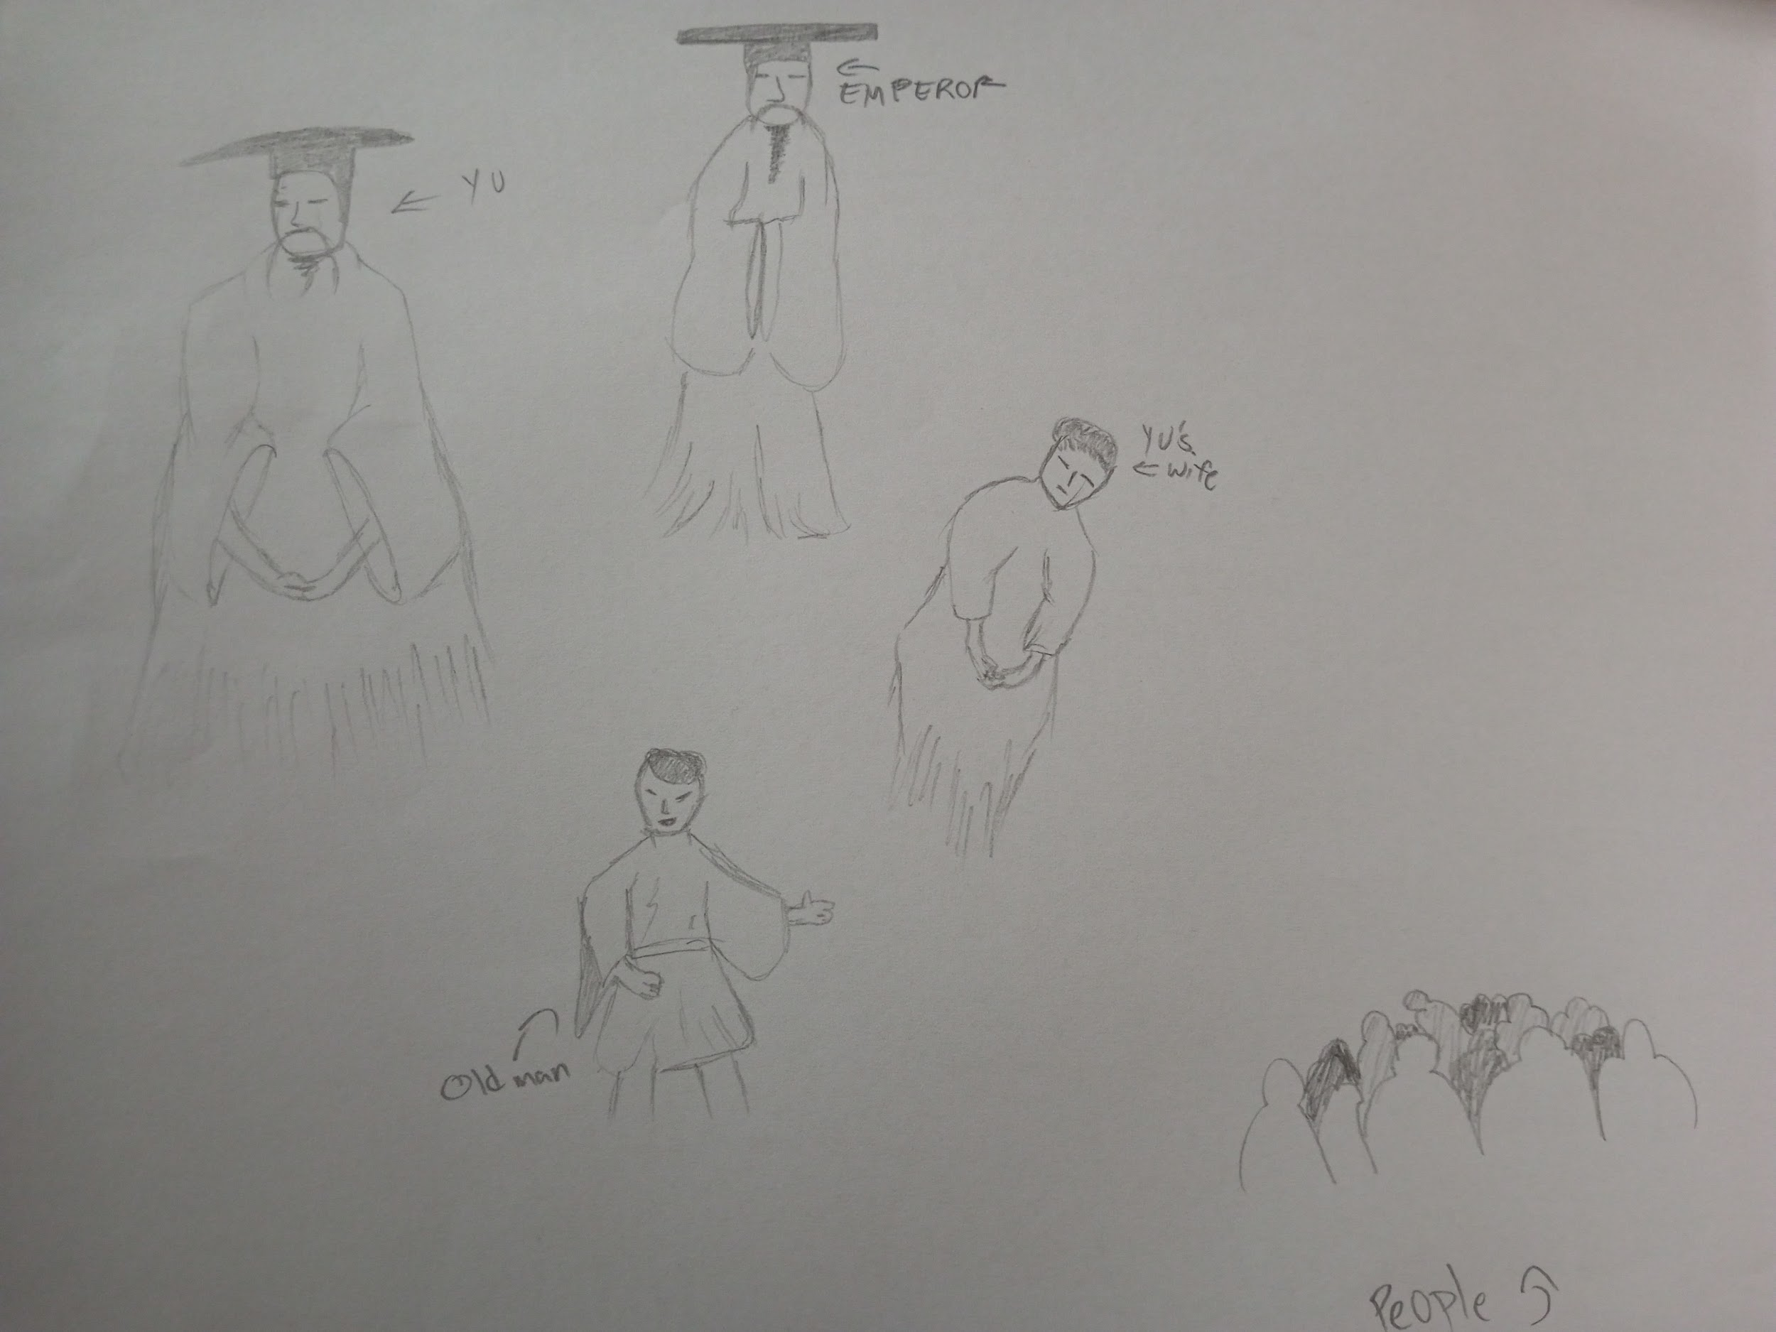
Sketches of the puppets:

Slide 3
The actual puppets:

Slide 4
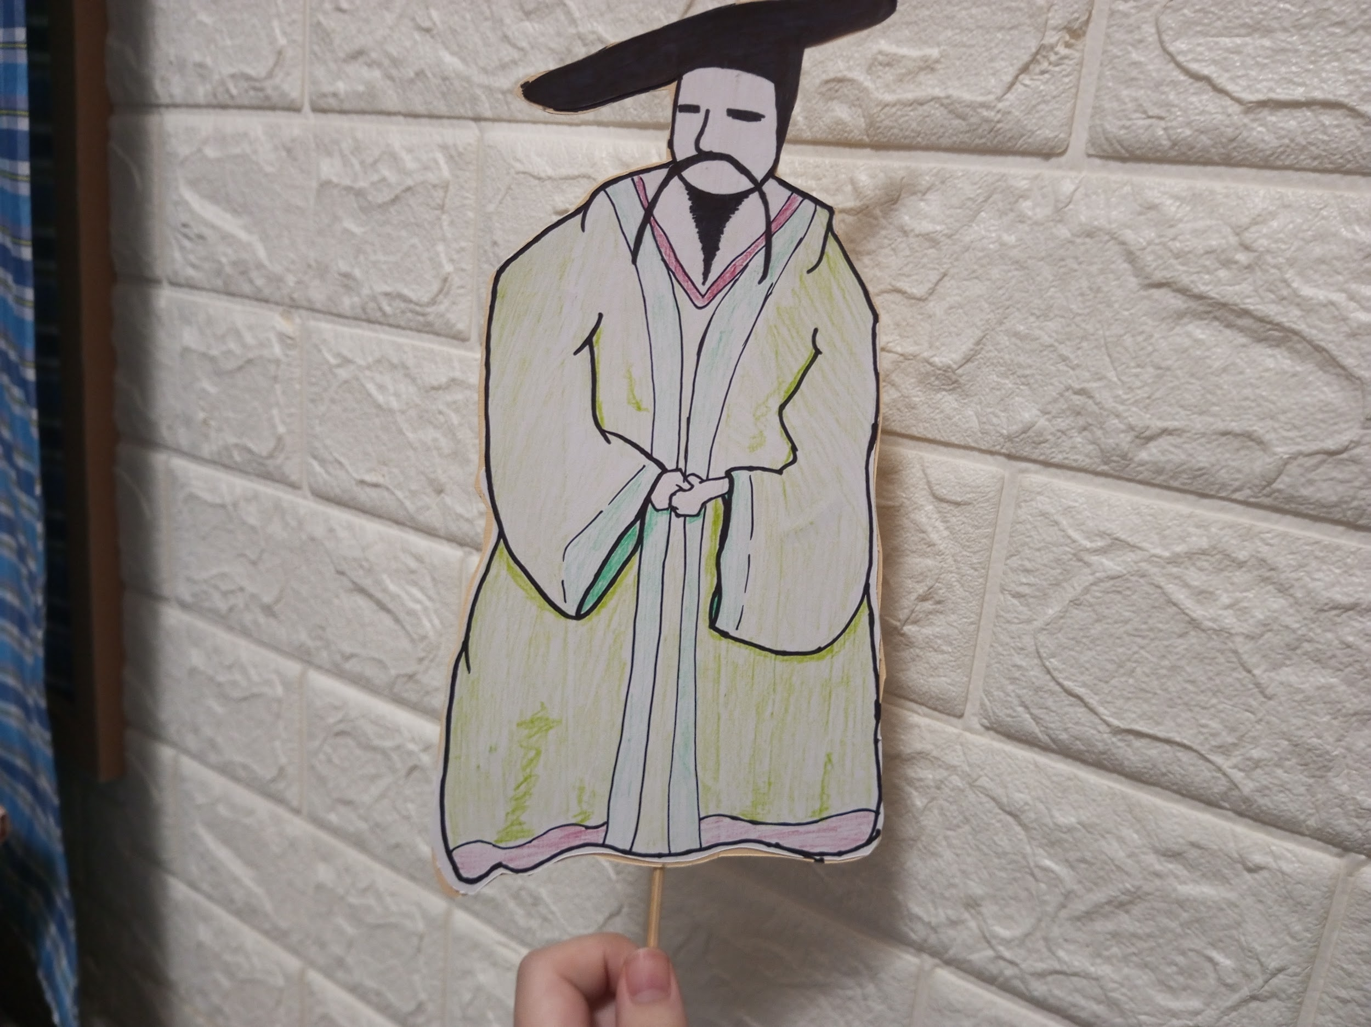

Slide 5
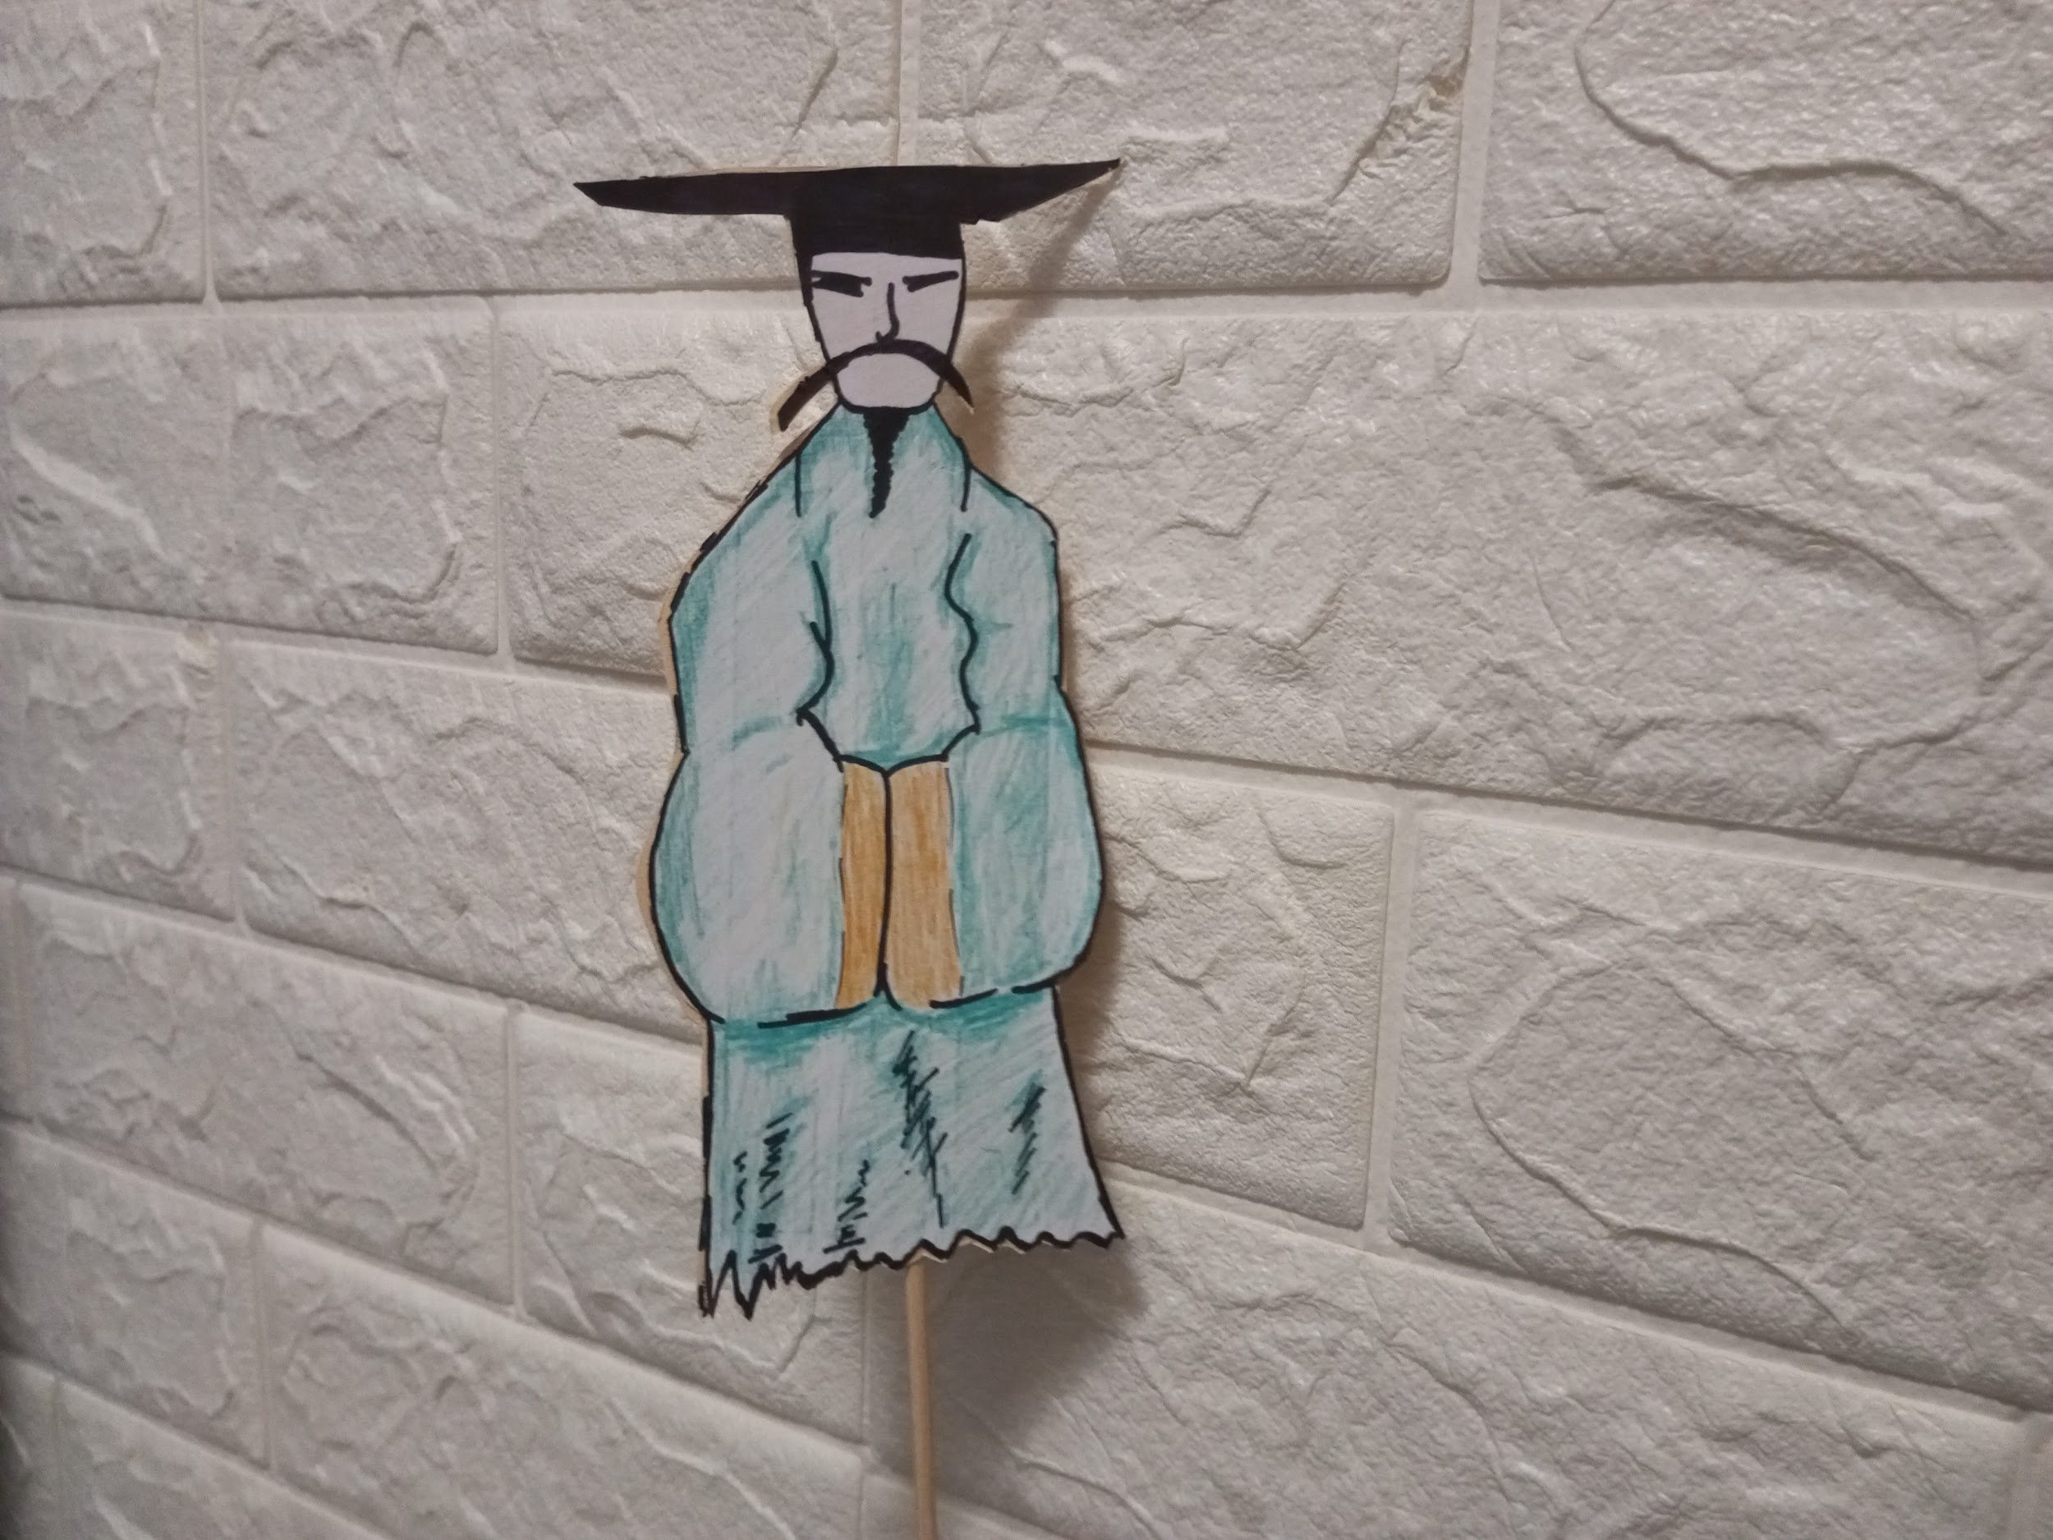

Slide 6
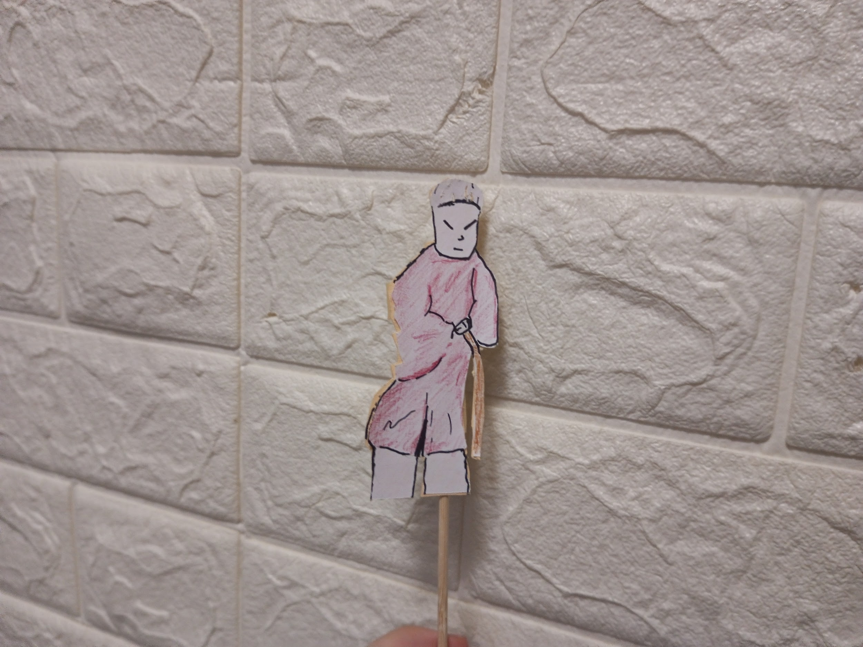

Slide 7
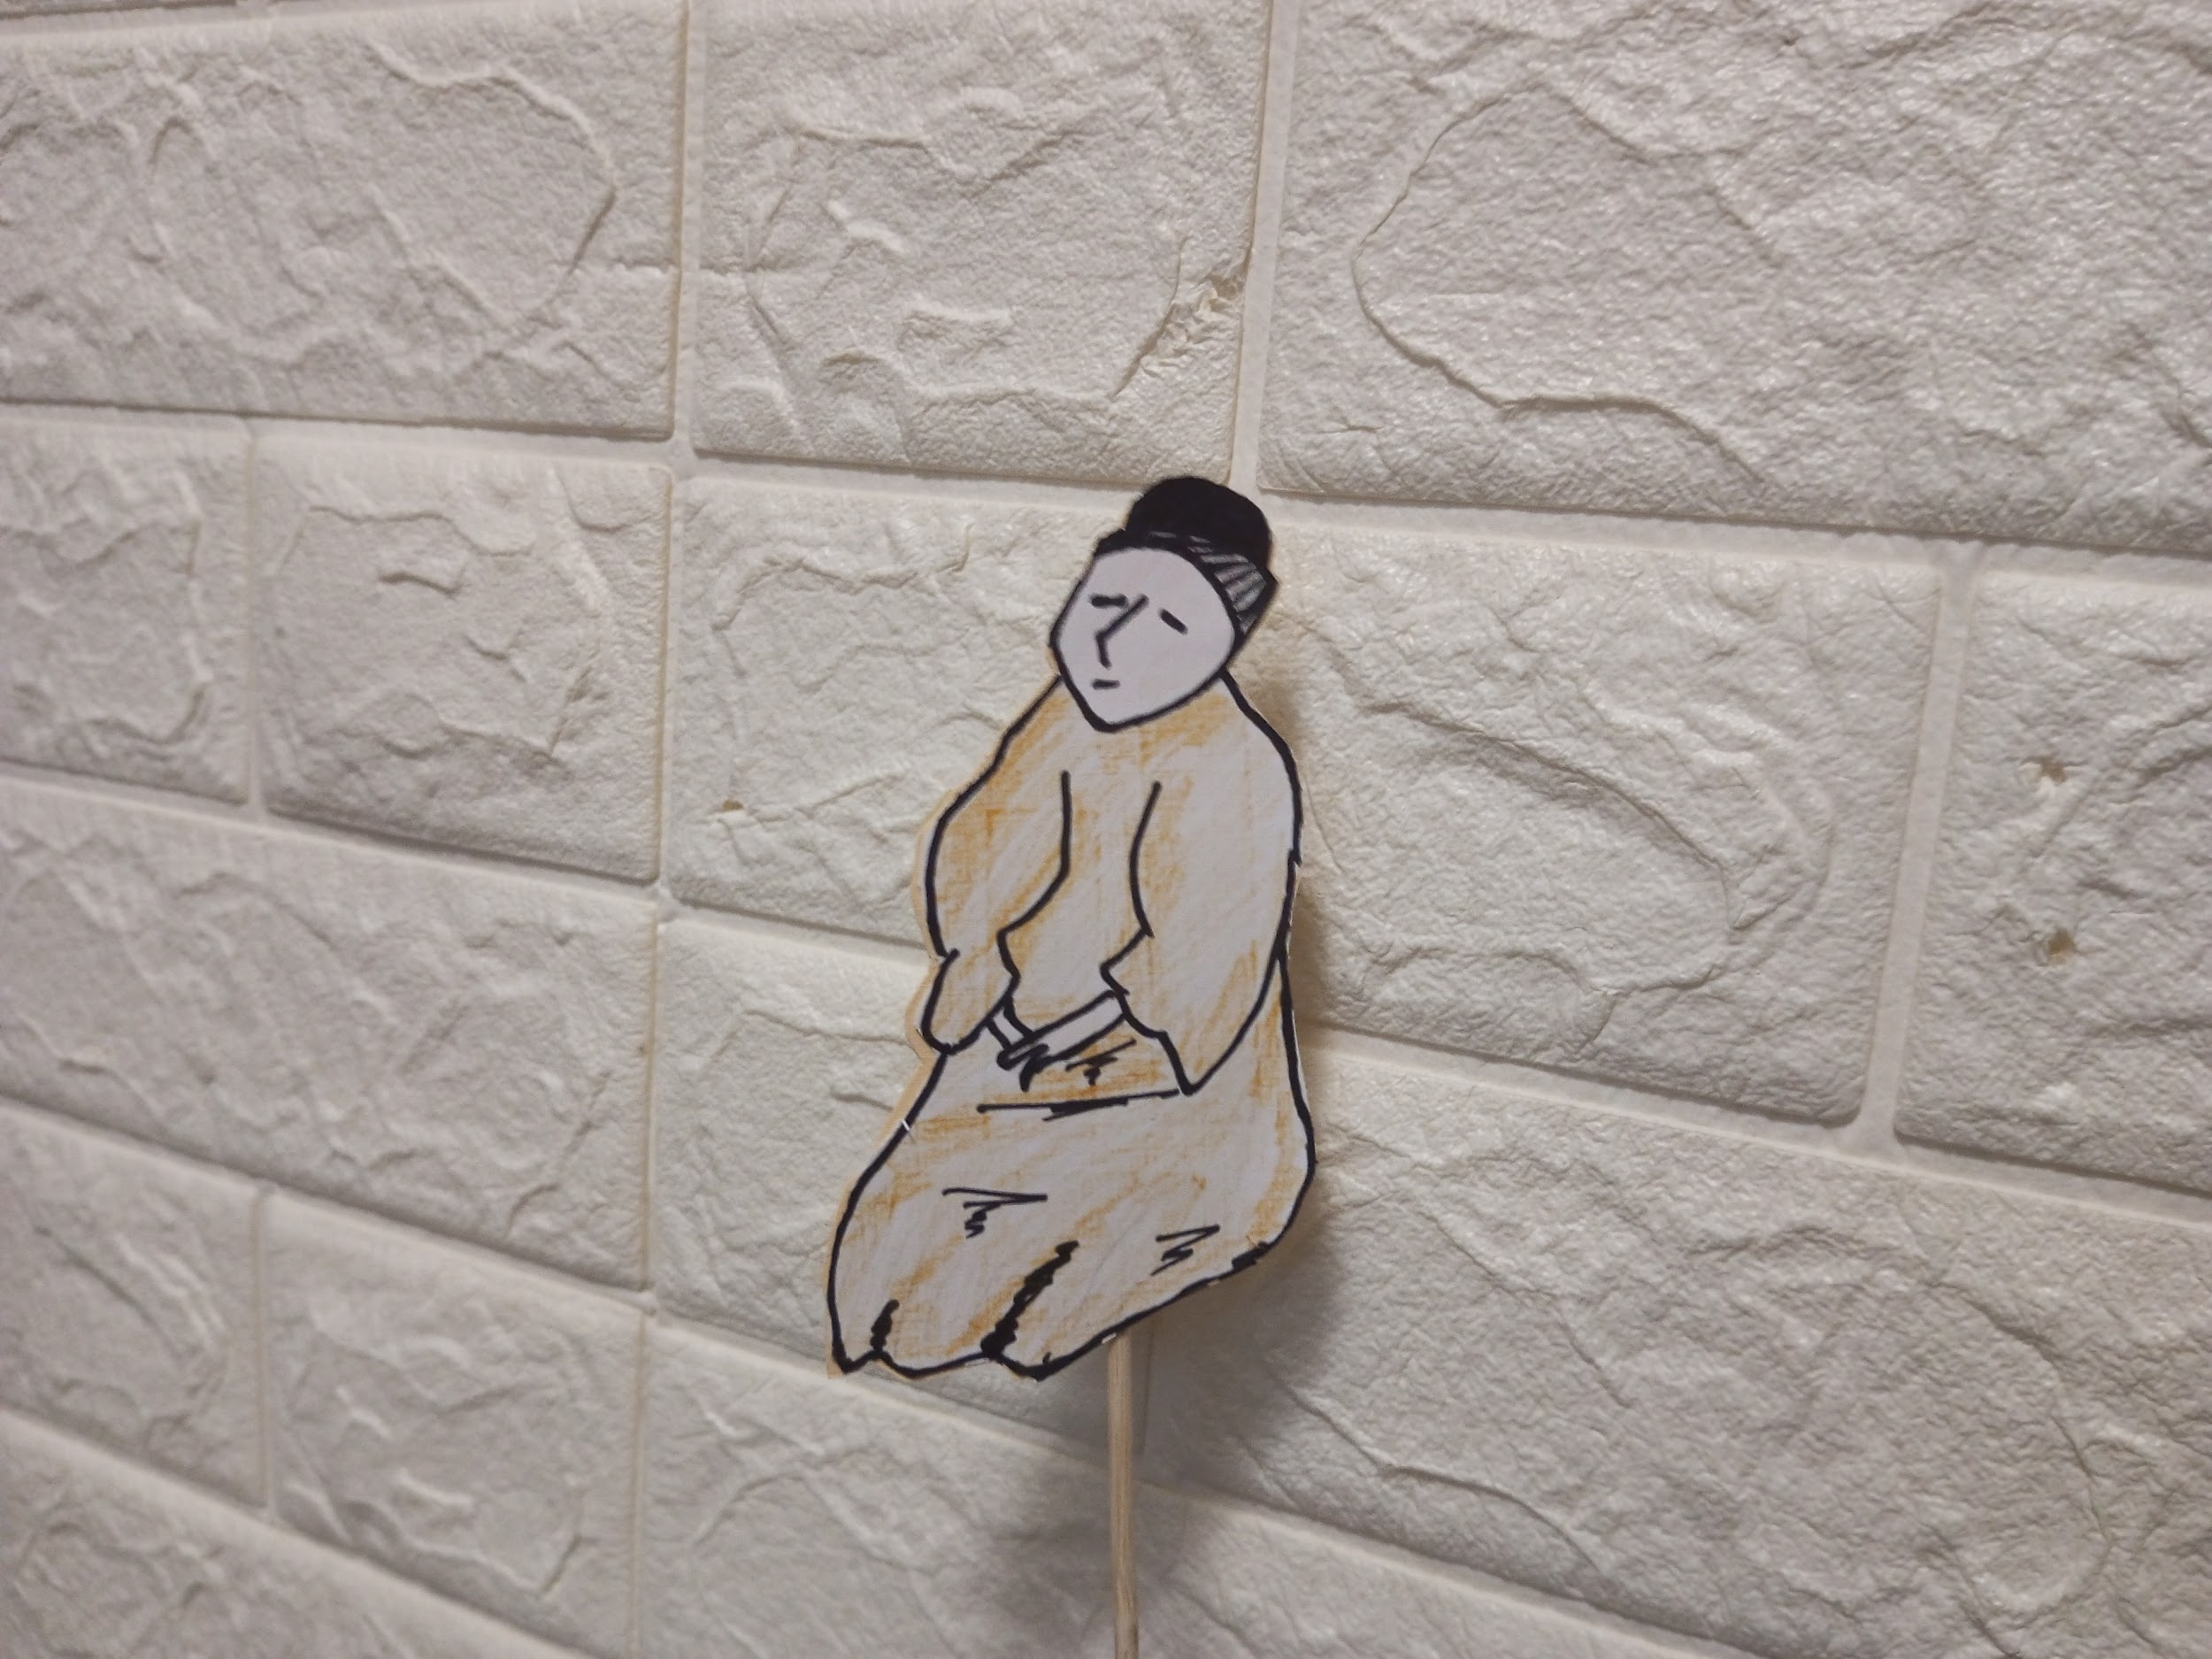

Slide 8
